Slide 1
Simulation of Quantum Dots
Group Project by Matthias Dittberner and Christian Funck

Slide 2
Overview
MATLAB Toolbox for QD-Simulations with OMEN
PbS QD Simulations with OMEN
Simulation Data: Analysis
Poster

Slide 3
TOM: Toolbox for OMEN in MATLAB
Simulation:
Starting simulations intuitively and efficiently via GUI
Automatically generate different parameter combinations
Managing the simulation data:
Overview over previous simulations
Filtering, deleting etc possible
Visualisation of simulation data
Different functions for plotting wave functions and energy levels

Slide 4
TOM: Toolbox for OMEN in MATLAB
Generic and clear structure: additional functionality can easily added (simulation parameters, plotting functions...).
Well documented

Slide 5
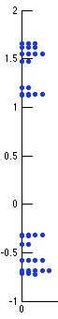
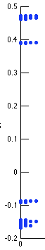
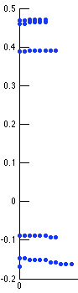
Energy levels for PbS QDs
Band edges: 8 quasi degenerate energy levels.
2nm QD
10nm QD
10nm QD, better visibility for (quasi) degenerate states.

Slide 6
Wave functions for band edge states, big QDs
Spherical shape: „1S orbitals“
Probability density for a CB state near bandedge, of a 8nm QD.

Slide 7
Wave functions for higher modes
Non spherical shapes: Probability density for CB modes 10, 14, 20.

Slide 8
Wave functions for small QDs
Near Band edge states: spherical symmetry of wave fn is lost for some states.
Close to reality?
Probability density for CB mode 3 of a 2nm QD.

Slide 9
Energy levels and electric field
Energy levels for a 5nm QD plotted against applied electric field.
Band gap gets smaller for higher fields.
8-fold degeneracy of band edge states is lost (twofold degenerate states remain).

Slide 10
Wave functions and electric field
Shift of wavefunction, depending on hole-like resp. electron-like character, to the left or right.

